Slide 1
A Take on SignalR
Iurii Khrystiuk

Slide 2
Agenda
Introduction
It’s that simple
Points of interest
What’s the catch?
Example
Conclusion
Q&A

Slide 3
Introduction
Released in 2013
Set of .Net and UI libraries
Real-time web communication
Multiple fallback protocols
Used as browser link technology

Slide 4
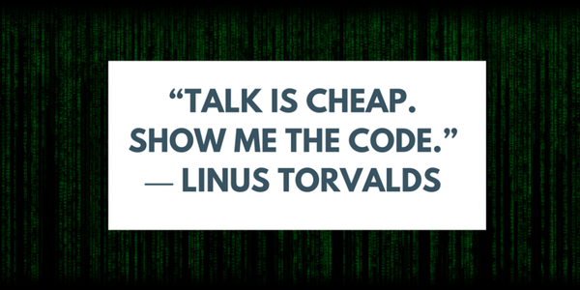

Slide 5
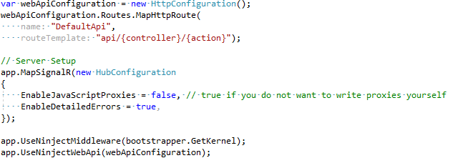
It’s That Easy: Server
OWIN integration
Separate pipeline
Limited tweaking options
Separate DI provider

Slide 6
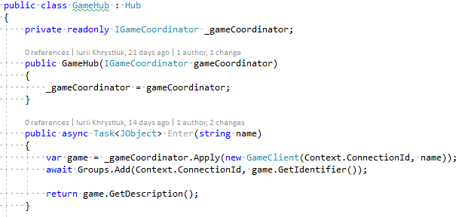
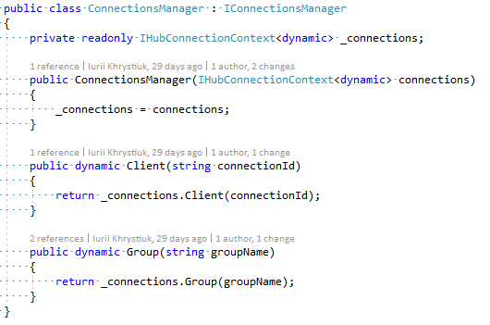
It’s That Easy: Hub
Custom hub has to inherit “Hub” class
Access to connection context
Groups management
Events management

Slide 7
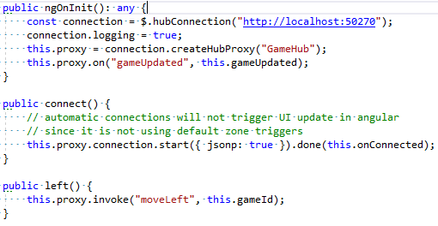
It’s That Easy: Client
Connection must be started and closed
Configuration for multiple protocols
At least one “event handler”

Slide 8
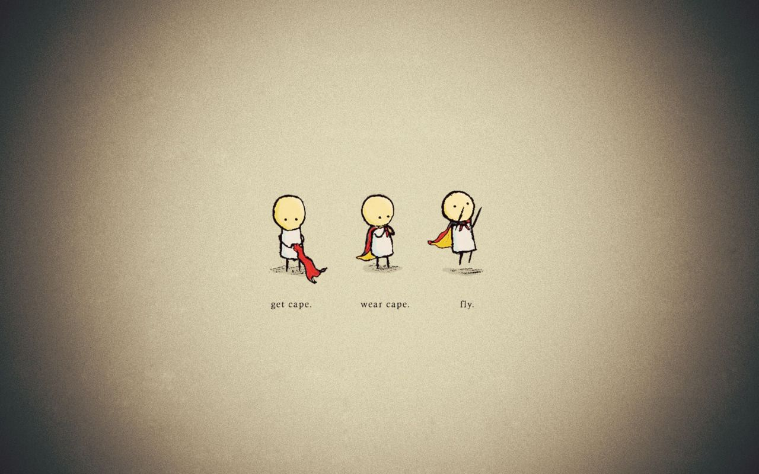

Slide 9
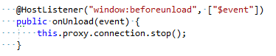
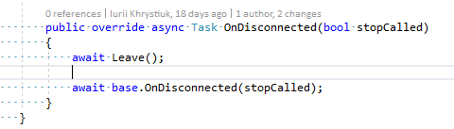
Points of interest
Hub Lifetime
Per request scope
No resources can be cached or saved in instance!
Auto generated client
Injects ASP.NET module
Cannot be bundled or minified
Connection management

Slide 10
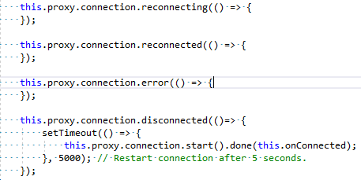
Points of interest
Events handling
Documentation
Every API is documented
Very helpful examples
Enough to get started

Slide 11


Slide 12
What’s the catch: .Net vs .Net Core
ASP.NET versions supported
OWIN is required
Dependent on jQuery
UI libraries are not UMD compatible
SPA integration is tricky

Slide 13
What’s the catch: Miscellaneous
Web Sockets are tricky
DI with SignalR
Client state management

Slide 14
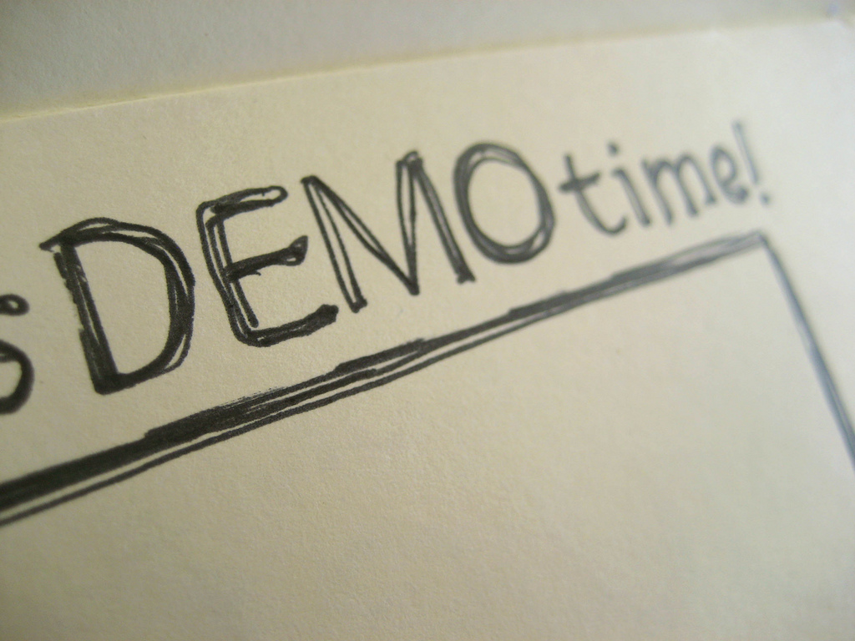

Slide 15
Conclusions
Quite easy to setup
Good configurability and extensibility
Good documentation
Bad SPA integration
Absent in .Net Core
Issues with internal state management

Slide 16
Thank You!

Slide 17
Useful Links
https://docs.microsoft.com/en-us/aspnet/signalr/
https://github.com/iuriikhrystiuk/conference/tree/master/TalkIT-31-05-2017

